Slide 1
Concurrency Control
1 Purpose of Concurrency Control
To enforce Isolation (through mutual exclusion) among conflicting transactions.
To preserve database consistency through consistency preserving execution of transactions.
To resolve read-write and write-write conflicts.
Example:
In concurrent execution environment if T1 conflicts with T2 over a data item A, then the existing concurrency control decides if T1 or T2 should get the A and if the other transaction is rolled-back or waits.

Slide 2
If 2 or more transaction are made to execute concurrently then they should result in a consistent state after the execution of all the transactions same as prior to their execution i.e they should be serializable schedule.
A number of concurrency control techniques are applied in a concurrent database and one type of technique is locking the data item to prevent multiple transaction from accessing the items concurrently.
Another set of protocol use timestamp.

Slide 3
Locking technique: A lock is a variable associated with each data item that describes the status of the item with respect to possible operations that can be applied to it.
Types of lock: depending upon types of lock the data manager gives or denies access to other operations on the same data item
Binary Locks: will have 2 values locked and unlocked
represented as 0 and 1.
A transaction sends a request to a datamanager to access to a dataitem by first locking the data item using LOCK() operation .At this moment if any other operation.
Transcation tries to access same data item then it is forced to wait untill the transaction (previous one) that has locked the dataitem unlock the data item using unlocked command.

Slide 4
Few rules must be followed when binary locking technique is used.
LOCK() : operation must be issued by transaction before any update operation like read() or write() operation are performed on transaction.
LOCK() :can’t be issued by transaction if already holds LOCK() on data item
UNLOCK() : must be issued after all read() and write() operations are completed in a transaction.
UNLOCK(): can’t be issued by transaction unless it already hold the lock on the data item.

Slide 5
Example for binary lock
T1:LOCK(A)
T1:READ(A)
T1:A:=A+200 A=300
T1:WRITE(A)
T1:UNLOCK(A)
T2:LOCK(A)
T2:READ(A)
T2:A:=A+300 A=600
T2:WRITE(A) A=600
T2:UNLOCK(A)
This example is seriazible schedule.Therefore, in case of a binary locking mechanism atmost one transaction can hold the lock on a particular dataitem .Thus no transaction can access the same item concurrently.
A=100
A=300

Slide 6
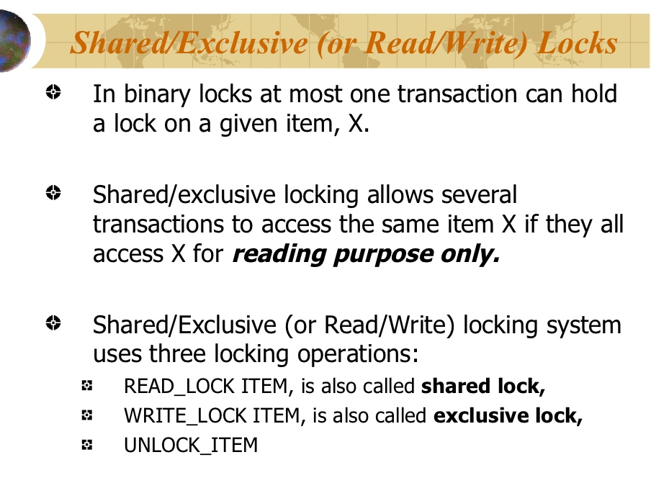

Slide 7
Database Concurrency Control
Two-Phase Locking Techniques
Locking is an operation which secures
(a) permission to Read
(b) permission to Write a data item for a transaction.
Example:
Lock (X). Data item X is locked in behalf of the requesting transaction.
Unlocking is an operation which removes these permissions from the data item.
Example:
Unlock (X): Data item X is made available to all other transactions.
Lock and Unlock are Atomic operations.

Slide 8
Database Concurrency Control
Two-Phase Locking Techniques: Essential components
Two locks modes:
(a) shared (read) (b) exclusive (write).
Shared mode: shared lock (X)
More than one transaction can apply share lock on X for reading its value but no write lock can be applied on X by any other transaction.
Exclusive mode: Write lock (X)
Only one write lock on X can exist at any time and no shared lock can be applied by any other transaction on X.
Conflict matrix

Slide 9
Database Concurrency Control
Two-Phase Locking Techniques: Essential components
Lock Manager:
Managing locks on data items.
Lock table:
Lock manager uses it to store the identity of transaction locking a data item, the data item, lock mode and pointer to the next data item locked. One simple way to implement a lock table is through linked list.

Slide 10
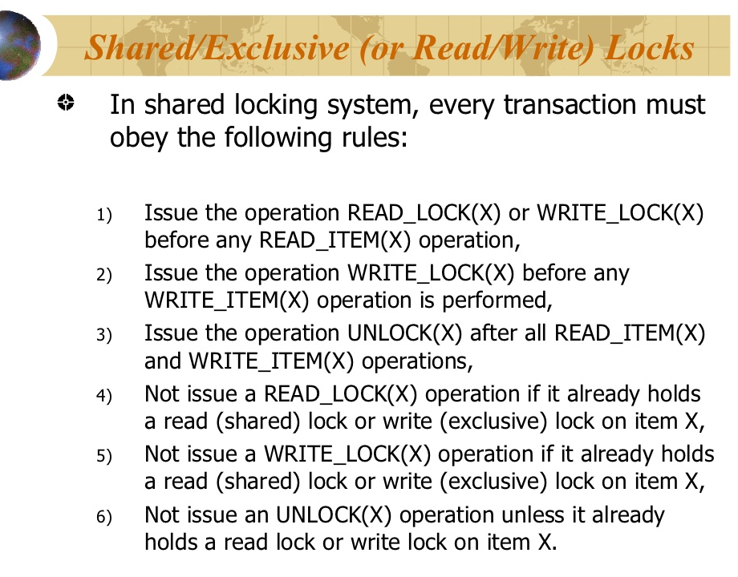

Slide 11
Database Concurrency Control
Two-Phase Locking Techniques: Essential components
Database requires that all transactions should be well-formed. A transaction is well-formed if:
It must lock the data item before it reads or writes to it.
It must not lock an already locked data items and it must not try to unlock a free data item.

Slide 12
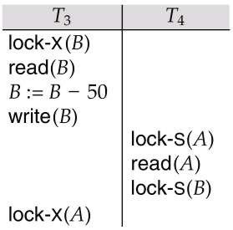
Pitfalls of Lock-Based Protocols
Consider the partial schedule
Neither T₃ nor T₄ can make progress — executing lock-S(B) causes T₄ to wait for T₃ to release its lock on B, while executing lock-X(A) causes T₃ to wait for T₄ to release its lock on A.
Such a situation is called a deadlock.
To handle a deadlock one of T₃ or T₄ must be rolled back and its locks released.

Slide 13
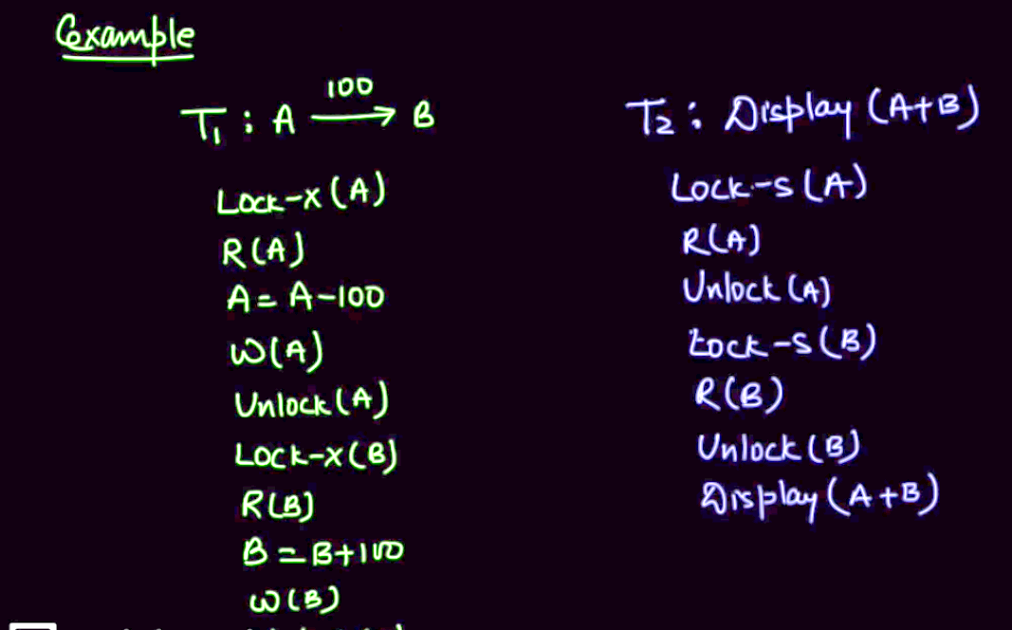

Slide 14
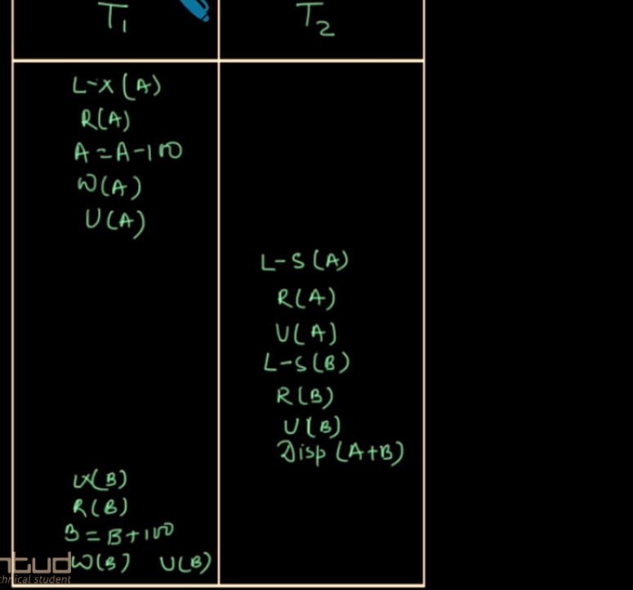

Slide 15
Database Concurrency Control
Two-Phase Locking Techniques: The algorithm
Two Phases:
(a) Locking (Growing)
(b) Unlocking (Shrinking).
Locking (Growing) Phase:
A transaction applies locks (read or write) on desired data items one at a time.
Unlocking (Shrinking) Phase:
A transaction unlocks its locked data items one at a time.
Requirement:
For a transaction these two phases must be mutually exclusively, that is, during locking phase unlocking phase must not start and during unlocking phase locking phase must not begin.

Slide 16
Database Concurrency Control
Two-Phase Locking Techniques: Essential components
Lock conversion
Lock upgrade: existing read lock to write lock
if Ti has a read-lock (X) and Tj has no read-lock (X) (i ≠ j) then
convert read-lock (X) to write-lock (X)
else
force Ti to wait until Tj unlocks X
Lock downgrade: existing write lock to read lock
Ti has a write-lock (X) (*no transaction can have any lock on X*)
convert write-lock (X) to read-lock (X)

Slide 17
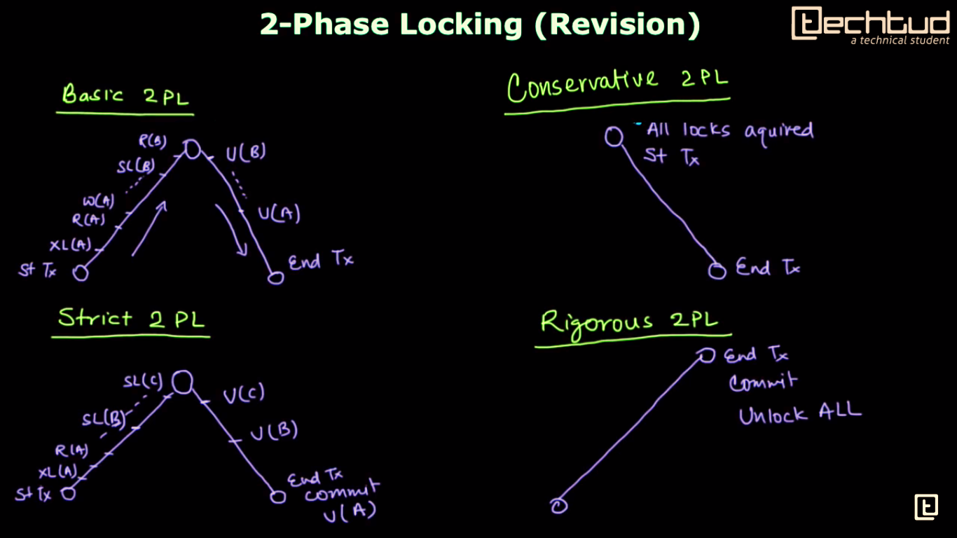

Slide 18
Database Concurrency Control
Two-Phase Locking Techniques: Essential components
The following code performs the lock operation:
B: if LOCK (X) = 0 (*item is unlocked*)
then LOCK (X) ← 1 (*lock the item*)
else begin
wait (until lock (X) = 0) and
the lock manager wakes up the transaction);
goto B
end;

Slide 19
Database Concurrency Control
Two-Phase Locking Techniques: Essential components
The following code performs the unlock operation:
LOCK (X) ← 0 (*unlock the item*)
if any transactions are waiting then
wake up one of the waiting transactions;

Slide 20
Database Concurrency Control
Two-Phase Locking Techniques: Essential components
The following code performs the read operation:
B: if LOCK (X) = “unlocked” then
begin LOCK (X) ← “read-locked”;
no_of_reads (X) ← 1;
end
else if LOCK (X) ← “read-locked” then
no_of_reads (X) ← no_of_reads (X) +1
else begin wait (until LOCK (X) = “unlocked” and
the lock manager wakes up the transaction);
go to B
end;

Slide 21
Database Concurrency Control
Two-Phase Locking Techniques: Essential components
The following code performs the write lock operation:
B: if LOCK (X) = “unlocked” then
LOCK (X) ← “write-locked”;
else begin
wait (until LOCK (X) = “unlocked” and
the lock manager wakes up the transaction);
go to B
end;

Slide 22
Database Concurrency Control
Two-Phase Locking Techniques: Essential components
The following code performs the unlock operation:
if LOCK (X) = “write-locked” then
begin LOCK (X) ← “unlocked”;
wakes up one of the transactions, if any
end
else if LOCK (X) ← “read-locked” then
begin
no_of_reads (X) ← no_of_reads (X) -1
if no_of_reads (X) = 0 then
begin
LOCK (X) = “unlocked”;
wake up one of the transactions, if any
end
end;

Slide 23
Database Concurrency Control
Two-Phase Locking Techniques: The algorithm
T1 T2 Result
read_lock (Y); read_lock (X); Initial values: X=20; Y=30
read_item (Y); read_item (X); Result of serial execution
unlock (Y); unlock (X); T1 followed by T2
write_lock (X); Write_lock (Y); X=50, Y=80.
read_item (X); read_item (Y); Result of serial execution
X:=X+Y; Y:=X+Y; T2 followed by T1
write_item (X); write_item (Y); X=70, Y=50
unlock (X); unlock (Y);

Slide 24
Database Concurrency Control
Two-Phase Locking Techniques: The algorithm
T1 T2 Result
read_lock (Y); X=50; Y=50
read_item (Y); Nonserializable because it.
unlock (Y); violated two-phase policy.
read_lock (X);
read_item (X);
unlock (X);
write_lock (Y);
read_item (Y);
Y:=X+Y;
write_item (Y);
unlock (Y);
write_lock (X);
read_item (X);
X:=X+Y;
write_item (X);
unlock (X);
Time

Slide 25
Database Concurrency Control
Two-Phase Locking Techniques: The algorithm
T’1 T’2
read_lock (Y); read_lock (X); T1 and T2 follow two-phase
read_item (Y); read_item (X); policy but they are subject to
write_lock (X); Write_lock (Y); deadlock, which must be
unlock (Y); unlock (X); dealt with.
read_item (X); read_item (Y);
X:=X+Y; Y:=X+Y;
write_item (X); write_item (Y);
unlock (X); unlock (Y);

Slide 26
Database Concurrency Control
Two-Phase Locking Techniques: The algorithm
Two-phase policy generates two locking algorithms
(a) Basic
(b) Conservative
Conservative:
Prevents deadlock by locking all desired data items before transaction begins execution.
Basic:
Transaction locks data items incrementally. This may cause deadlock which is dealt with.
Strict:
A more stricter version of Basic algorithm where unlocking is performed after a transaction terminates (commits or aborts and rolled-back). This is the most commonly used two-phase locking algorithm.

Slide 27
Database Concurrency Control
Timestamp based concurrency control algorithm
Timestamp
A monotonically increasing variable (integer) indicating the age of an operation or a transaction. A larger timestamp value indicates a more recent event or operation.
Timestamp based algorithm uses timestamp to serialize the execution of concurrent transactions.

Slide 28
Database Concurrency Control
Each transaction is issued a timestamp when it enters the system. If an old transaction Ti has time-stamp TS(Ti), a new transaction Tj is
assigned time-stamp TS(Tj) such that TS(Ti) <TS(Tj).
The protocol manages concurrent execution such that the timestamps determine the serializability order.
In order to assure such behavior, the protocol maintains for each data
Q two timestamp values:
W-timestamp(Q) is the largest time-stamp of any transaction that
executed write(Q) successfully.
R-timestamp(Q) is the largest time-stamp of any transaction that
executed read(Q) successfully.

Slide 29
Database Concurrency Control
Timestamp based concurrency control algorithm
Basic Timestamp Ordering
1. Transaction T issues a write_item(X) operation:
If read_TS(X) > TS(T) or if write_TS(X) > TS(T), then an younger transaction has already read the data item so abort and roll-back T and reject the operation.
If the condition in part (a) does not exist, then execute write_item(X) of T and set write_TS(X) to TS(T).
2. Transaction T issues a read_item(X) operation:
If write_TS(X) > TS(T), then an younger transaction has already written to the data item so abort and roll-back T and reject the operation.
If write_TS(X) ≤ TS(T), then execute read_item(X) of T and set read_TS(X) to the larger of TS(T) and the current read_TS(X).

Slide 30
Database Concurrency Control
Timestamp based concurrency control algorithm
Strict Timestamp Ordering
1. Transaction T issues a write_item(X) operation:
If TS(T) > read_TS(X), then delay T until the transaction T’ that wrote or read X has terminated (committed or aborted).
2. Transaction T issues a read_item(X) operation:
If TS(T) > write_TS(X), then delay T until the transaction T’ that wrote or read X has terminated (committed or aborted).

Slide 31
Database Concurrency Control
Timestamp based concurrency control algorithm
Thomas’s Write Rule
If read_TS(X) > TS(T) then abort and roll-back T and reject the operation.
If write_TS(X) > TS(T), then just ignore the write operation and continue execution. This is because the most recent writes counts in case of two consecutive writes.
If the conditions given in 1 and 2 above do not occur, then execute write_item(X) of T and set write_TS(X) to TS(T).

